Slide 1
Social Media
By: Nikoloz Muladze

Slide 2
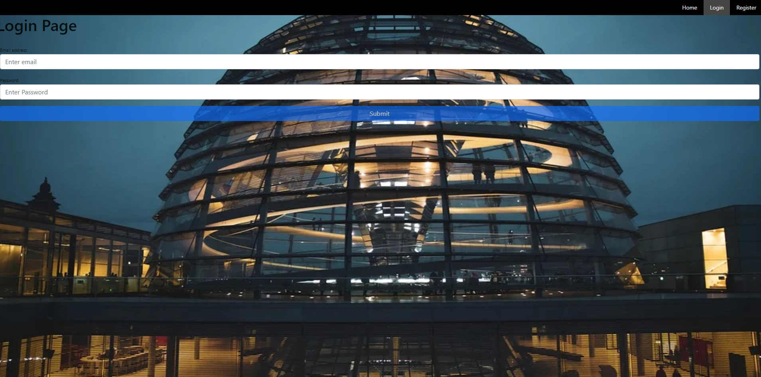
Login Page

Slide 3
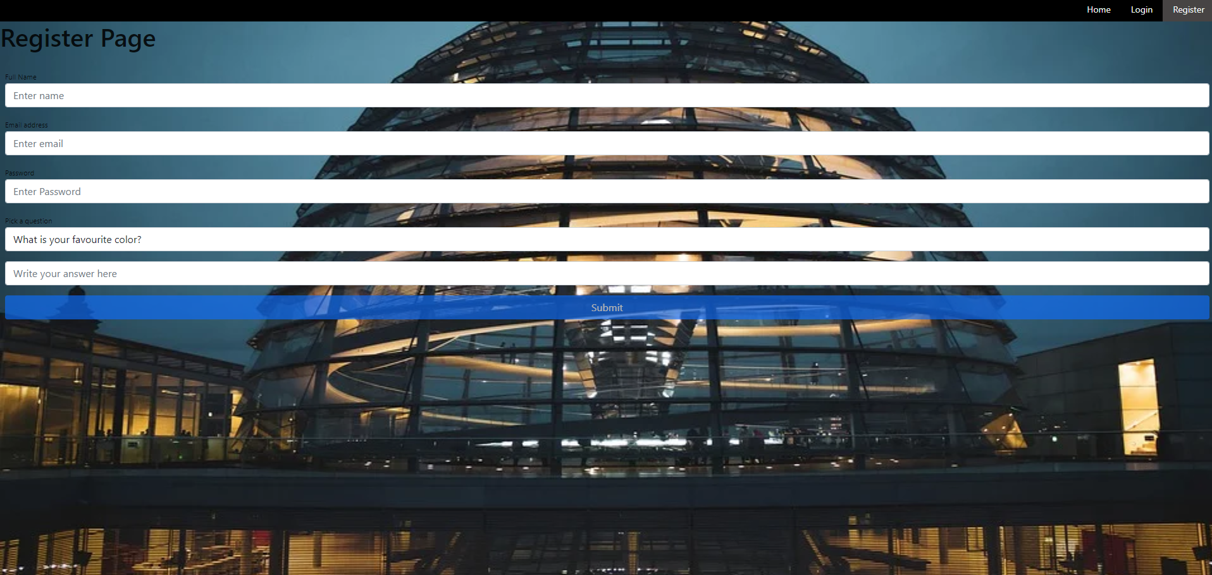
Register Page

Slide 4
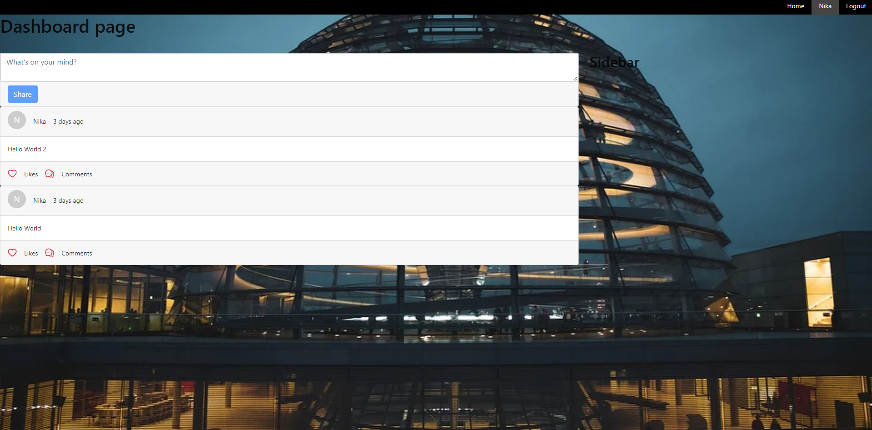
Dashboard Page

Slide 5
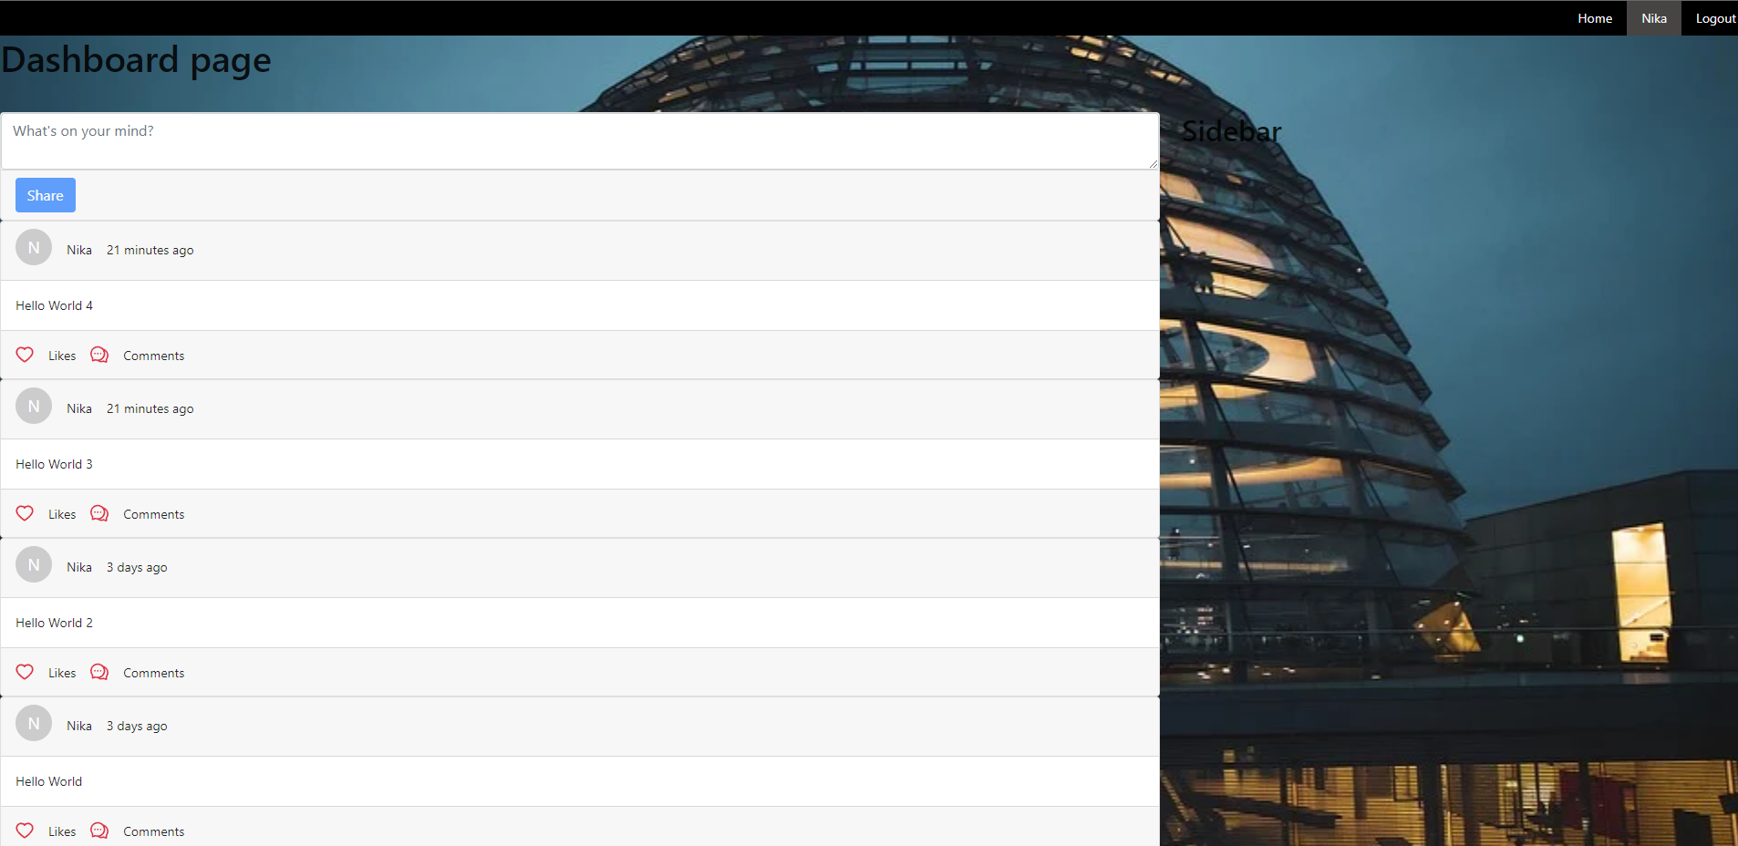
Dashboard Page 2

Slide 6
What is MERN?
MongoDB – Source-available cross-platform document-oriented database
Express – back-end web application framework for Node.js
React – front-end JavaScript library for building user interfaces or UI components
Node – back-end JavaScript runtime environment that runs on the V8 engine and executes JavaScript code outside a web browser

Slide 7
Why MERN?
React is maintained by Facebook, one of the tech giants
The whole beauty of MERN is using Javascript for both front-end & back-end.
MERN uses 4 frameworks, in 1
Also, you need not hire different specialists for different technologies that will save a lot of money and time for the entrepreneurs.
React is evolving fast, and so does demand
Understanding React means understanding React Native that is used for both Android and IOS App development

Slide 8
Objectives
Creating a basic social media application with Posting and Chatting features
Possibly adding new features

Slide 9
References
Node.js and Express.js – Full Course 8 hours and 16 minutes - https://www.youtube.com/watch?v=Oe421EPjeBE
React Full Course – 10 hours - https://www.youtube.com/watch?v=4UZrsTqkcW4
MongoDB Course - 36 minutes - https://www.youtube.com/watch?v=-56x56UppqQ
Next.js Course – 3 hours and 14 minutes https://www.youtube.com/watch?v=MFuwkrseXVE
Whatsapp Clone with MERN 4 hours https://www.youtube.com/watch?v=gzdQDxzW2Tw
https://github.com/CodeEventHorizon/whatsapp-clone

